Slide 1
Application for Startups
11th Cycle - 2026

Slide 2
1. Title Slide
INTRODUCE YOURSELF & YOUR IDEA/ PRODUCT/ SERVICE
Slide Layout
Include visual of your idea/product/service and logo (if available).
Questions to Answer
Who are you?
Why do you want to start your company?
Words of advice
Focus on engaging the audience and
deliver with high energy!

Slide 3
2. Problem
DEFINE THE “BIG” PROBLEM YOU’RE SOLVING
Slide Layout
Limited text, include keywords of
problem you’re solving.
Questions to Answer
What problem are you solving?
Why should your audience pay attention to you?
Words of advice
Use concise language to articulate the problem and its impact.

Slide 4
3. Solution
HOW IS YOUR PRODUCT SOLVING THE PROBLEM?
Slide Layout
Visuals of the idea/product and service (or anything else that can help the audience visualise your solution).
Questions To Answer
How does your idea for a product/service solve the
problem you defined in Slide 2?
Words of advice
Keep it simple, your grandmother
should understand it!

Slide 5
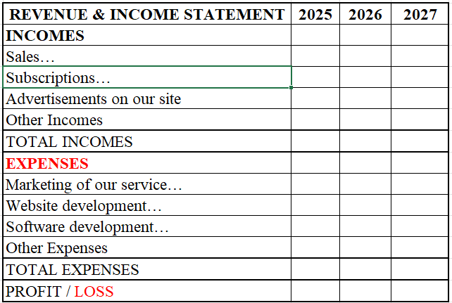
4. Projections / Traction / Progress
VISUALIZE YOUR PROGRESS TO DATE OR GROWTH PLAN
If you are at the idea stage, make projections of how you estimate your business to grow for 3 years
Slide Layout
Clear graph of traction and growth, pull out the key metrics the audience should remember. Use either revenue growth, user growth or whatever key metric shows your projected progress or proves your traction or progress to date. Present your go to market strategy if pre-launch and progress so far.
Questions to Answer
What will be your tractions/progress?
What’s been your traction/progress up to this point? (if any)
How do you intend to grow your traction in the future? (projections)
Words of advice
This slide is critical to keep the audience engaged.
Use NUMBERS & CALCULATIONS
Example
No decimals
In Euros
Right Justified numbers
By Year

Slide 6
5. Market Opportunity
HOW BIG IS THE MARKET YOU’RE TACKLING?
Slide Layout
Show your target market size (and/or its growth)
Questions to Answer
What is the specific market segment you’re tackling?
Is this is a growing market?
Words of advice
Everyone loves big target markets which are ripe for disruption by you!

Slide 7
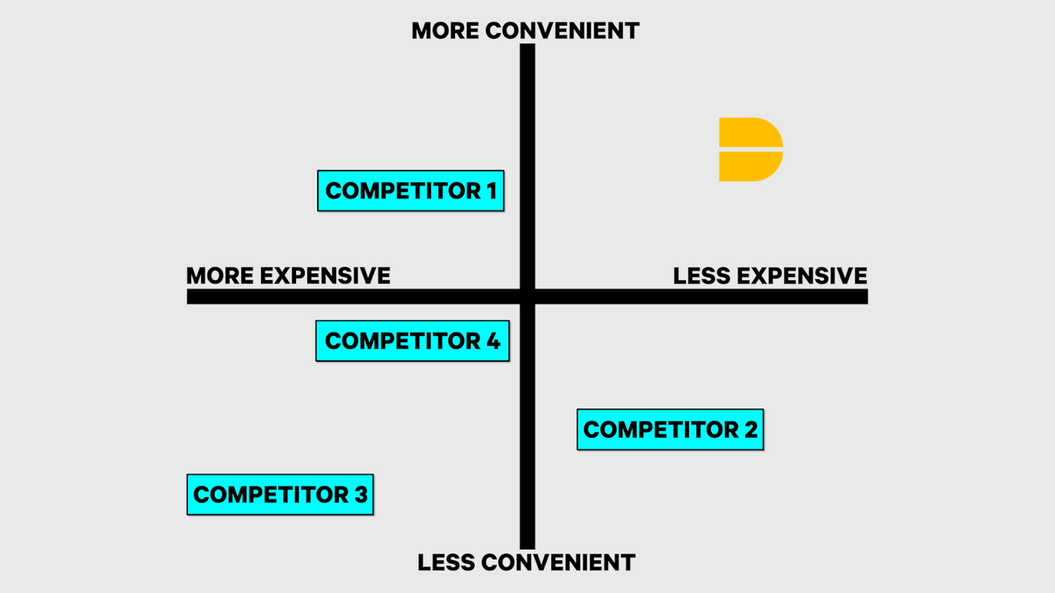
6. Competitive Edge
W H A T I S Y O U R S E C R E T S A U C E ?
Example
Slide Layout
Pull out and visualize (if possible) the key components that
differentiate your idea/product/service.
Questions to Answer
What is the secret sauce that will drive the growth of
your company?
Words of advice
Don’t get too deep discussing competitors but mention the main ones. Focus on your company. If there are some obvious huge competitors in the space, make sure you clearly articulate your difference “unlike x, we ____”.

Slide 8
7. Go to market strategy
W H A T I S Y O U R G O TO M A R K E T S T R A T E G Y?
Slide Layout
Go to market strategy
Questions to Answer
How will you reach to your customer?
What channels?
Words of advice
Show your expertise in reaching these channels
Show that you have already thought how to get them

Slide 9
8. Team
W H Y A R E Y O U T H E R I G H T T E A M T O W I N ?
Slide Layout
Include headshots and bios of key team members.
Pull out impressive past accomplishments (ie. industry experience,
previous companies etc.)
Questions to Answer
Who will be the co-founders/decision-makers?
Who are you?
Why are you a winning team?
Is there a software developer in the team as co-founder?
Words of advice
Keep it text light. Highlight relevant achievements.

Slide 10
9. Your commitment
H O W C O M M I T T E D W I L L Y O U B E I F S E L E C T E D
Questions to Answer
Which members of your team will be working full time on your company?
Which members of your team will be physically present at IDEA?
IDEA has a “Give, Share & Take” & collaboration culture.
What can you offer back to the IDEA family?

Slide 11
10. Why You? Why Now?
W H Y S H O U L D I D E A S E L E C T Y O U R P R O J E C T R I G H T N O W ?
Slide Layout
Use bullets to summarise and highlight key points.
Questions to Answer
Why is now the right time for your company/team to come to IDEA?
Why is this space ripe for disruption? Where will the IDEA incubation program get your company?
Words of advice
This is your time to summarise and tell the audience why your project should be selected. Make an impact and deliver with confidence.

